Slide 1
Adaptive EEG alpha power classification model
指導教授: 魏群樹
Group : 48
組員: 王昱力 陳威達

Slide 2
Motivation
Background
Brain-computer interfaces (BCIs) are increasingly used in medical fields.
Examples: Rehabilitation for stroke patients, aiding in the diagnosis of depression.
Challenges
EEG signals vary significantly between individuals and even within the same individual at different times.
These variations necessitate parameter adjustments for each user.

Slide 3

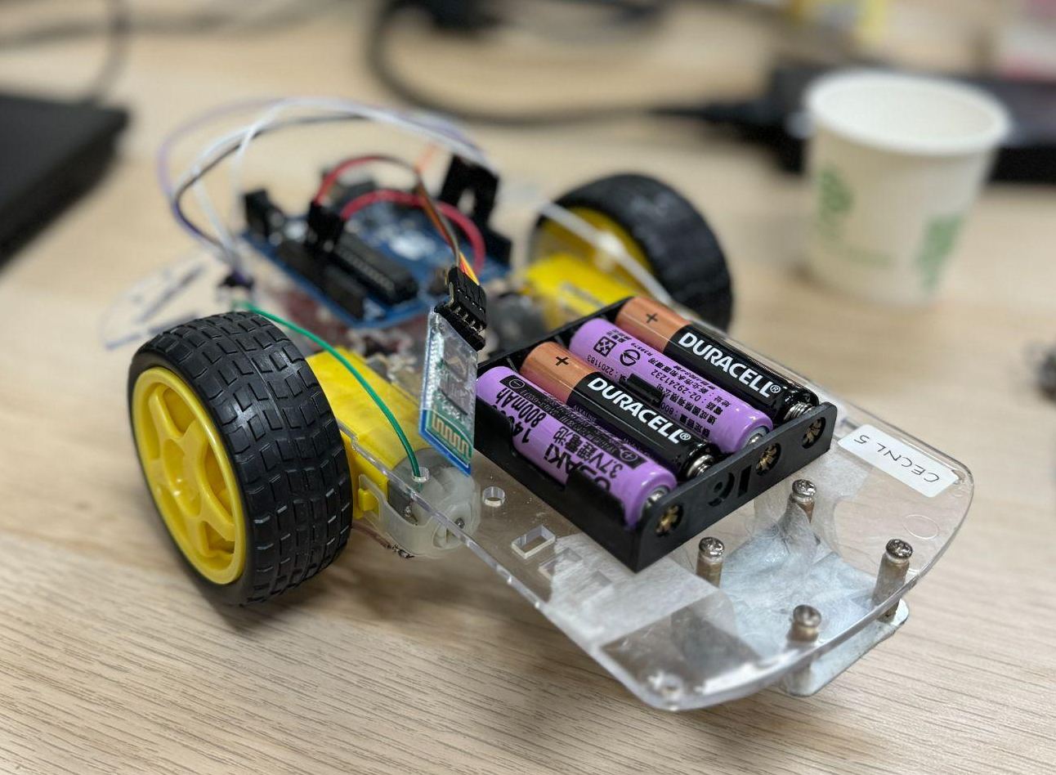
Motivation
Example Use Case
Controlling a remote-controlled car using the relative intensity of alpha waves when eyes are open or closed (alpha power ratio).
Car moves forward when alpha power ratio is below a threshold (eyes open).
Car stops when alpha power ratio is above a threshold (eyes closed).
Current Issues
Setting the threshold currently involves manual observation and repeated testing.
This process is time-consuming and needs to be repeated for each use.

Slide 4
Goal
Primary Objective
Develop an adaptive automated pipeline that can calculate the optimal threshold for EEG alpha power ratio.
Benefits
Immediate adaptation to the user's current state.
Eliminates the need for time-consuming manual threshold adjustments.
End Result
A system where users can put on an EEG cap and automatically obtain the best threshold for their alpha power ratio.

Slide 5
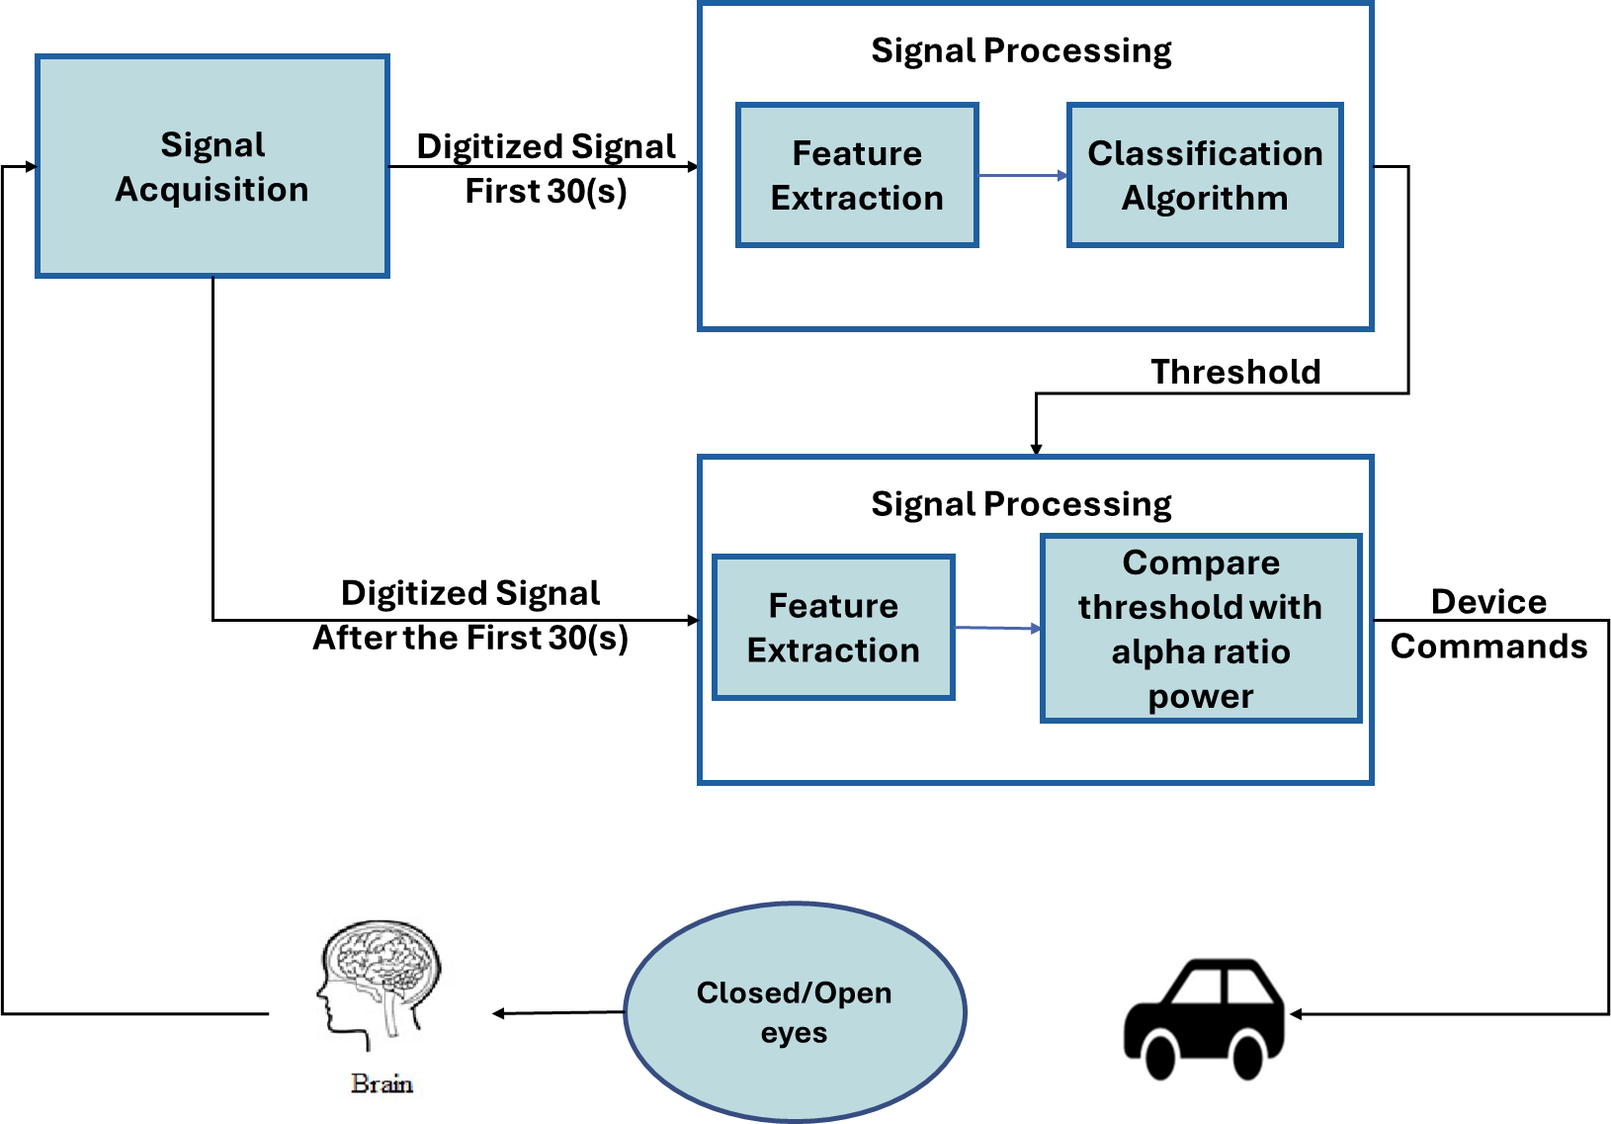
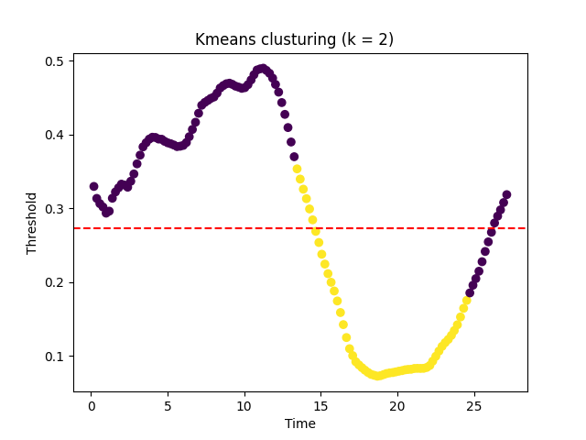
Method
Data Collection
EEG data is collected over 30 seconds, with the subject alternately closing and opening their eyes:
10 seconds eyes closed
10 seconds eyes open
10 seconds eyes closed
Modeling
Use the K-means clustering algorithm to label the collected alpha power ratio values.
Determine the threshold at the point of label transition.
Compute the average of these thresholds to find the optimal threshold.

Slide 6
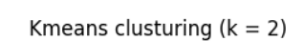
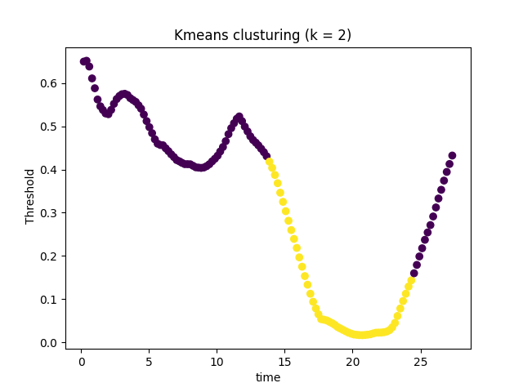
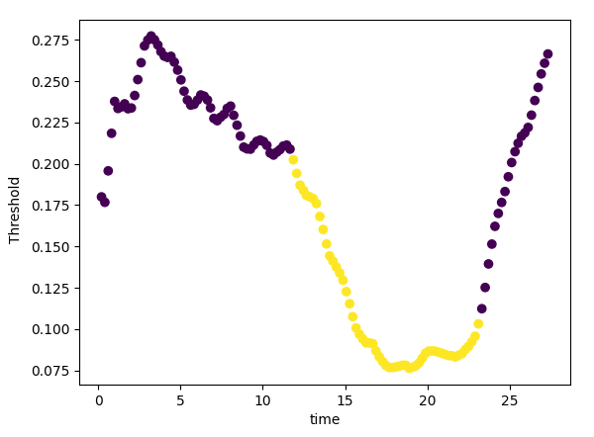
Result
Epoch = 1(s)
Interval between each epoch = 0.0625(s)
Subject 1
Subject 2
Label changes time:
11.66(s), 23.11(s)
13.67(s), 24.33(s)

Slide 7
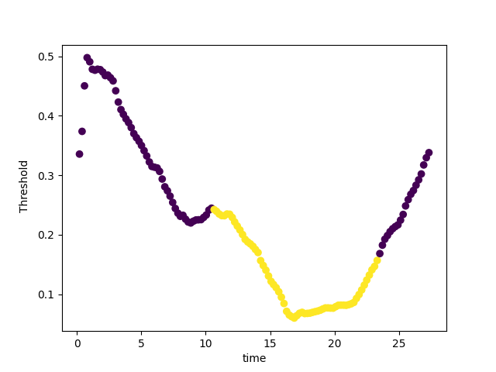
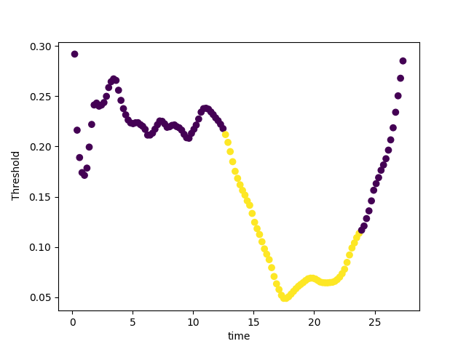
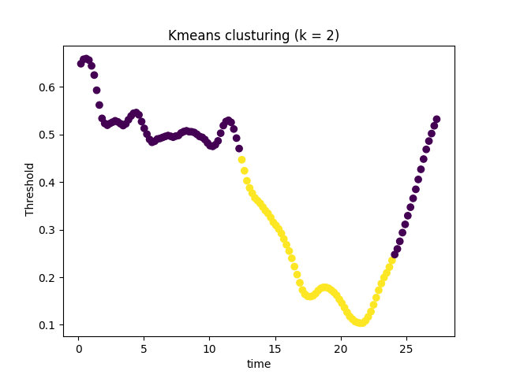
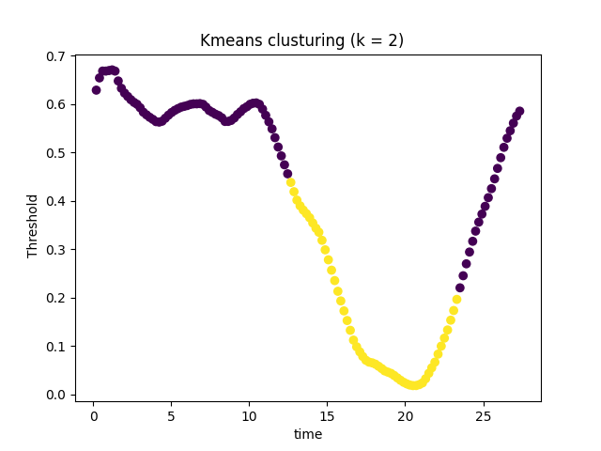
Ablation Study
Epoch = 0.5
Interval = 0.01
Subject 1
Label changes time:
10.45(s), 23.31(s)
12.47(s), 23.72(s)
Subject 2
Label changes time:
12.27(s), 23.9(s)
12.47(s), 23.31(s)

Slide 8

Demo

Slide 9
Thanks !!

